Slide 1






Foundations of
Quantum Computing
(QIS 301)
Dave Biersach
Brookhaven National Laboratory
dbiersach@bnl.gov
Session 06
2D Graphics
(Double Period)

Slide 2
Session Goals
Plot 2-D equations and scatter graphs using the Python package mplotlib and its pyplot functions
Relate pyplot's figure object to its axes object
Learn how to decorate plots with titles, labels, grids, etc.
Use the numpy package to create arrays of numbers
Use the sympy package to do exact symbolic (analytic) calculus (limits, derivatives, integrals, etc.)
Plot parametric equations using polar graphs
Combine multiple plots into a single output window

Slide 3
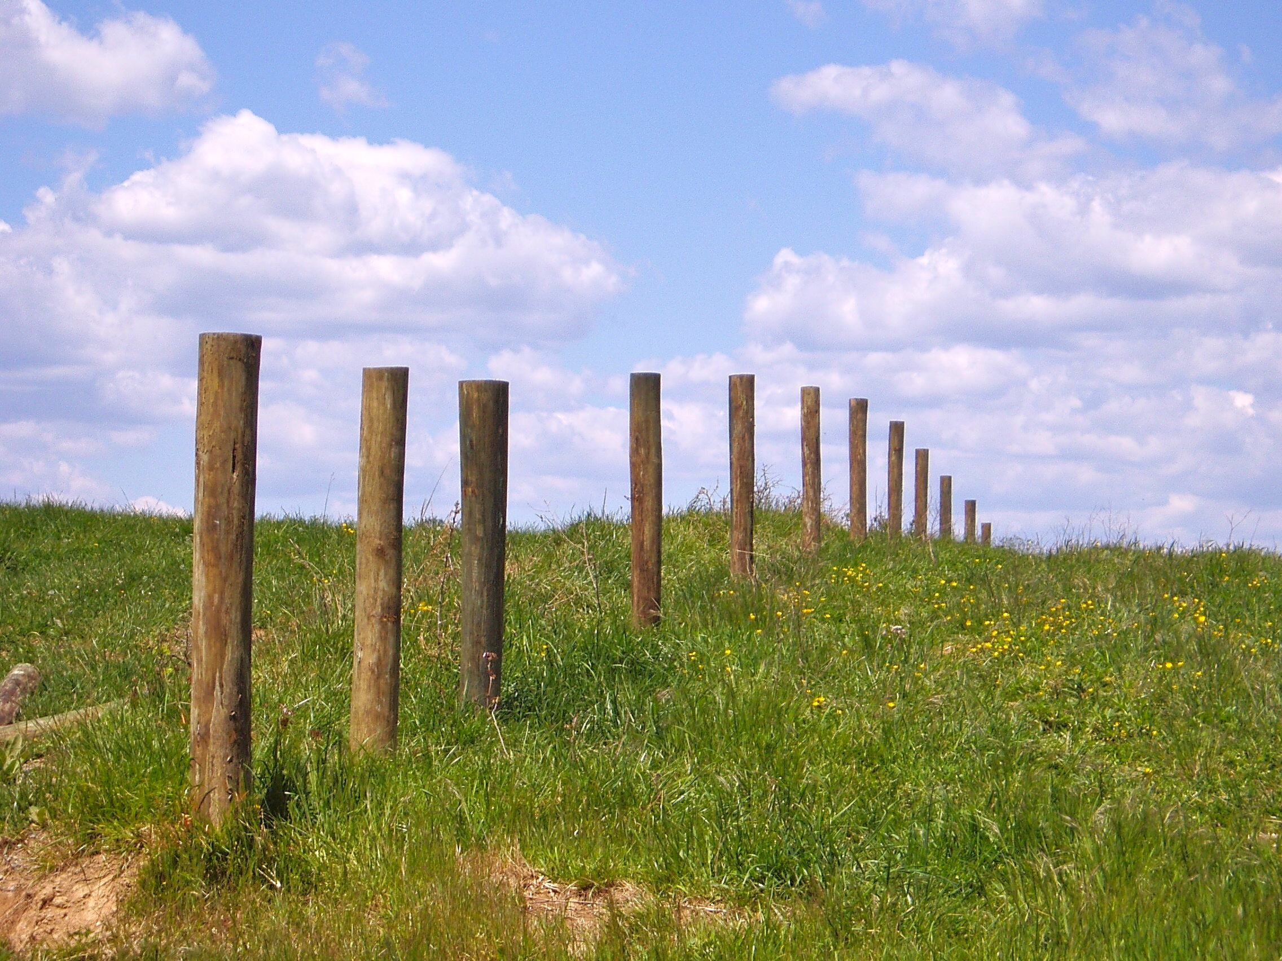
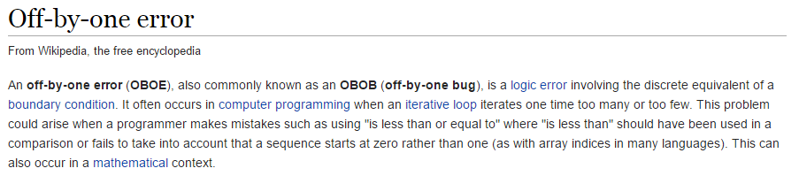
The Bane of All Programmers
This problem is why we all agree to always use ZERO as the first index value in an array.
Remember…
ZERO is a THING!
ZERO counts!
A farmer needs a fence 100m long
He wants 2m between each fence post
How many posts does he need?

Slide 4
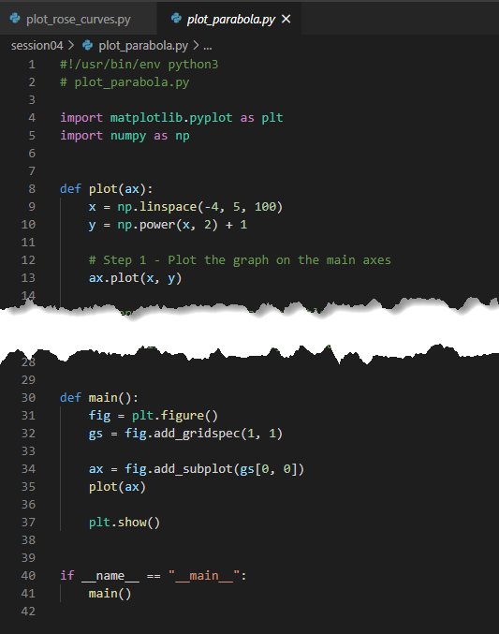
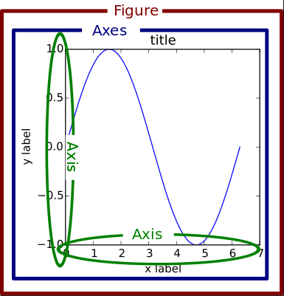
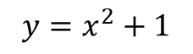
Open plot_parabola.py
①
$$y=x^{2}+1$$
https://numpy.org/doc/stable/reference/generated/numpy.linspace.html
④
https://matplotlib.org/3.3.3/api/_as_gen/matplotlib.pyplot.html
⑤
②
③
⑥

Slide 5
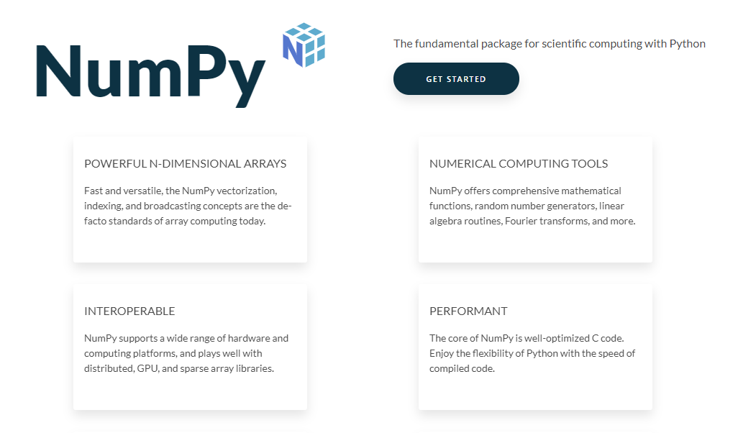
https://numpy.org

Slide 6
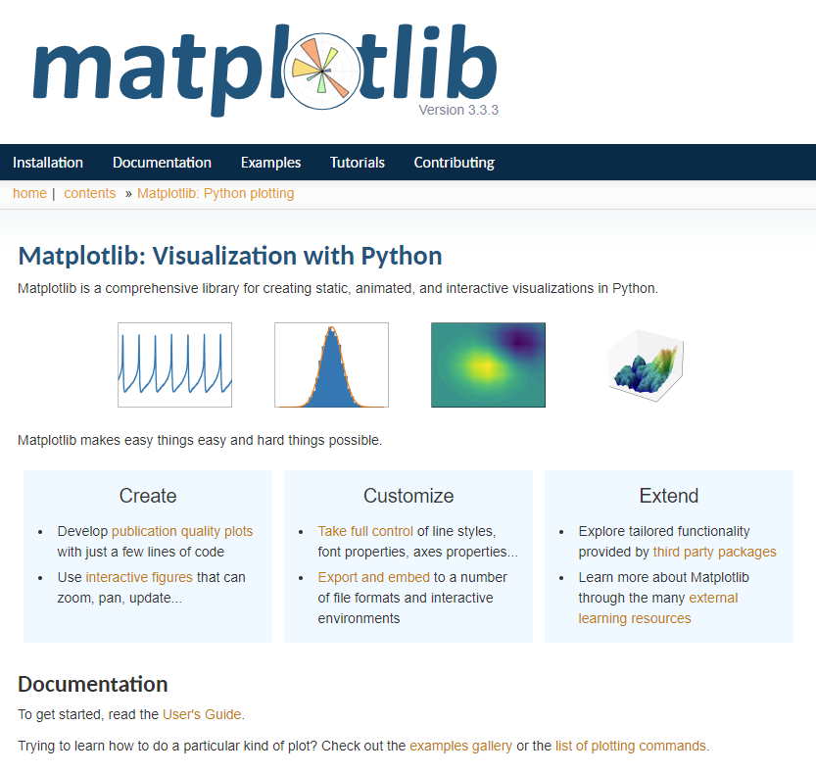
https://matplotlib.org

Slide 7
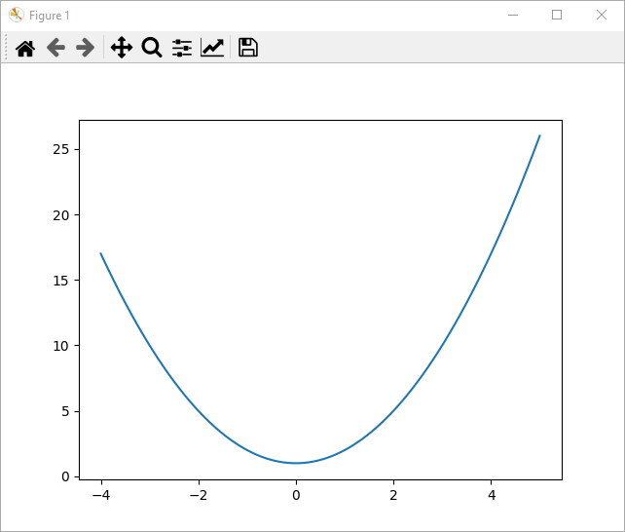
Run plot_parabola.py
Be sure to close the graph window before returning to VSCode

Slide 8
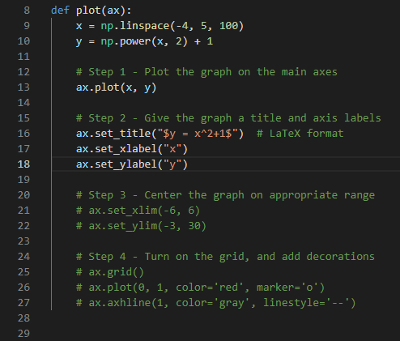
Edit plot_parabola.py
Uncomment lines 16 - 18

Slide 9
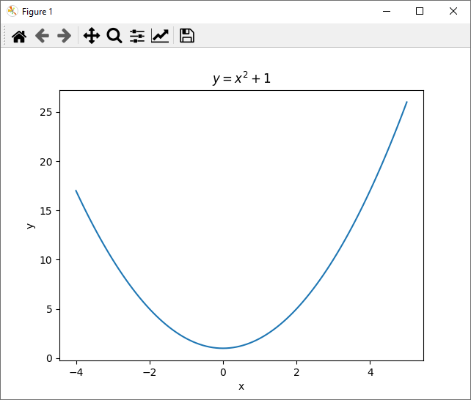
Run plot_parabola.py
Graphs should have a title and labeled axes

Slide 10
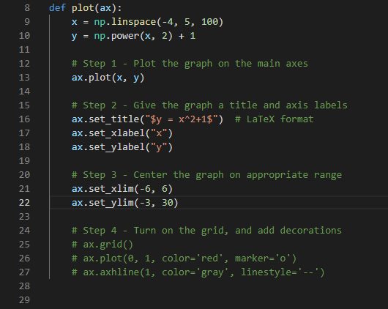
Edit plot_parabola.py
Uncomment lines 21 - 22

Slide 11
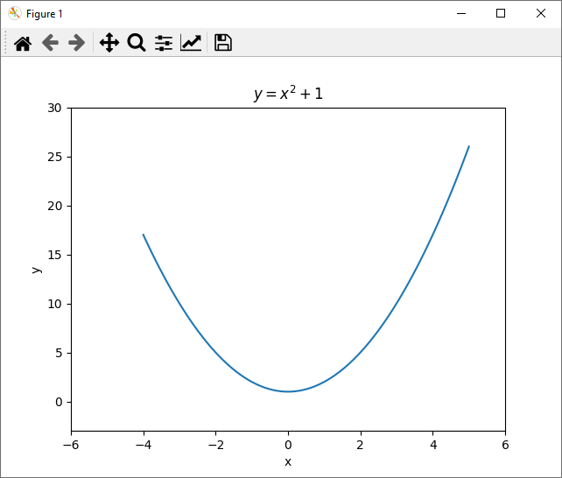
Run plot_parabola.py
The plot is now centered on 0

Slide 12
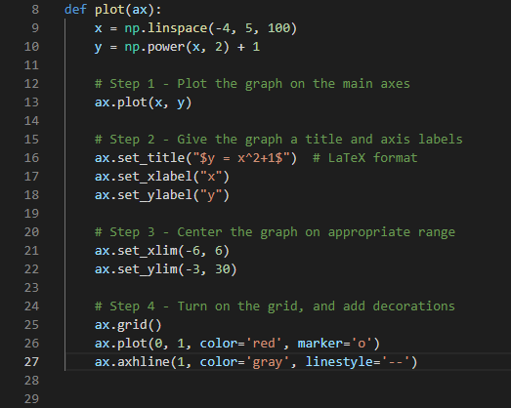
Edit plot_parabola.py
Uncomment lines 25 - 27

Slide 13
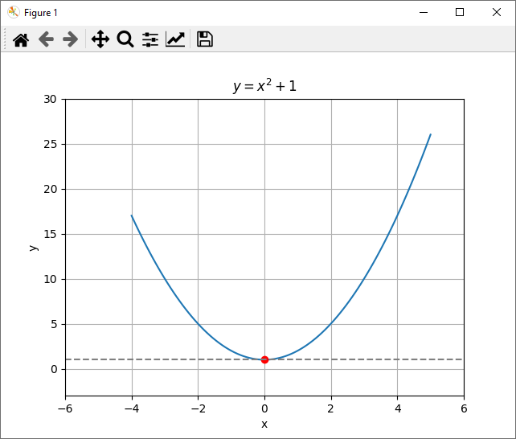
Run plot_parabola.py
We can decorate a plot with points, lines, grids, etc.

Slide 14
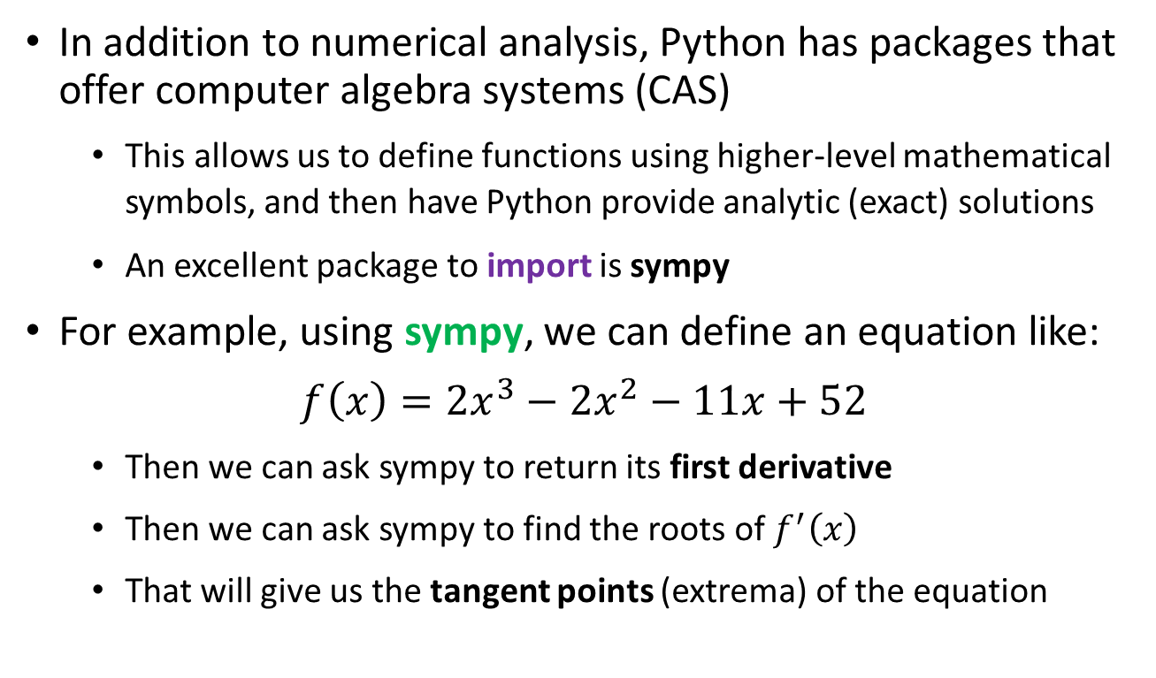
Symbolic Algebra & Calculus
In addition to numerical analysis, Python has packages that offer computer algebra systems (CAS)
This allows us to define functions using higher-level mathematical symbols, and then have Python provide analytic (exact) solutions
An excellent package to import is sympy
For example, using sympy, we can define an equation like:
$$f\left(x\right)=2x^{3}−2x^{2}−11x+52$$
Then we can ask sympy to return its first derivative
Then we can ask sympy to find the roots of $f^{′}\left(x\right)$
That will give us the tangent points (extrema) of the equation

Slide 15
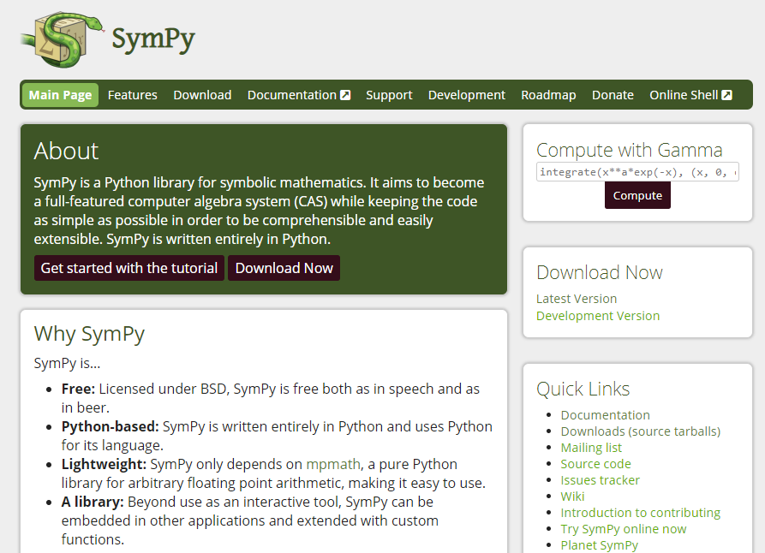
Symbolic Algebra & Calculus
https://www.sympy.org

Slide 16
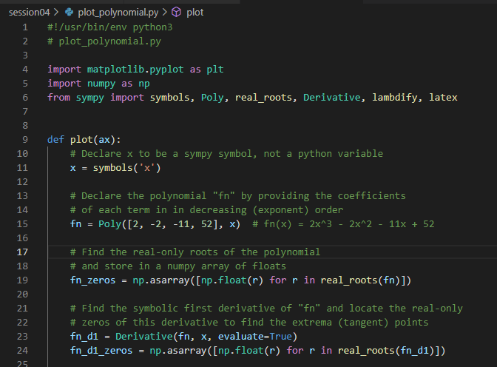
Open plot_polynomial.py
①
②
③
④
⑤
⑥

Slide 17
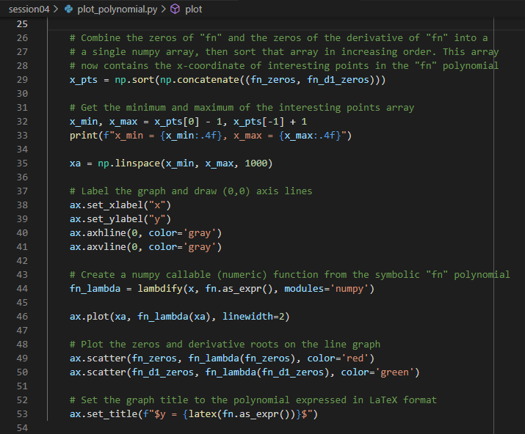
Continuing plot_polynomial.py
①
②
③
④
⑤
⑥

Slide 18
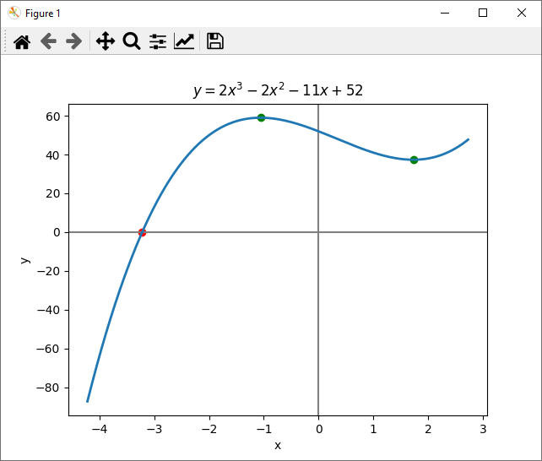
Run plot_polynomial.py
Local extrema points
Local extrema points
The one real root

Slide 19
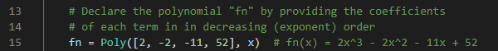
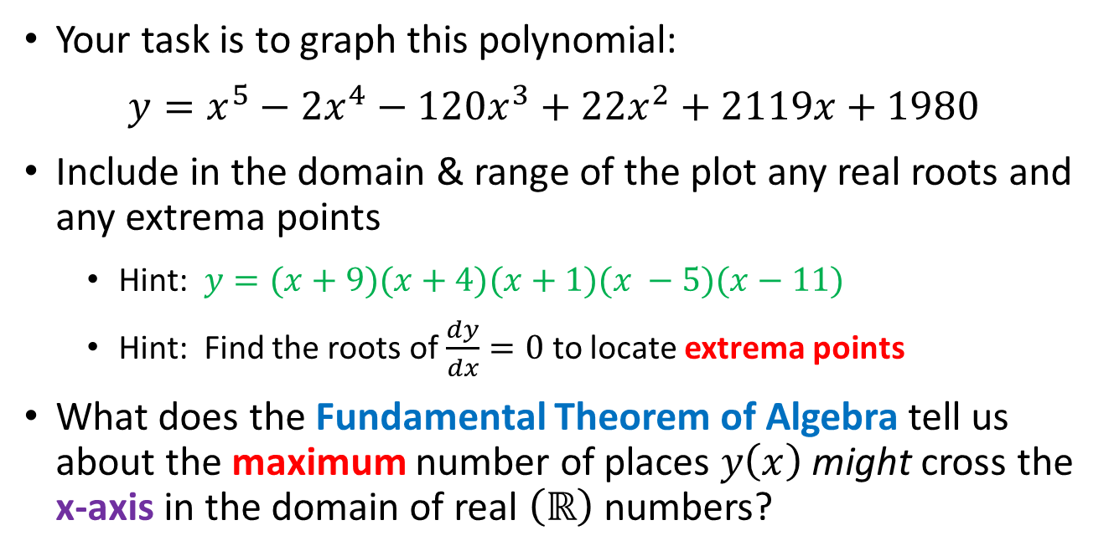
Edit plot_polynomial.py
Your task is to graph this polynomial:
$y=x^{5}−{2x}^{4}−120x^{3}+22x^{2}+2119x+1980$
Include in the domain & range of the plot any real roots and any extrema points
Hint: $y=(x+9)(x+4)(x+1)(x −5)(x−11)$
Hint: Find the roots of $\frac{dy}{dx}=0$ to locate extrema points
What does the Fundamental Theorem of Algebra tell us about the maximum number of places $y\left(x\right)$ might cross the x-axis in the domain of real $\left(ℝ\right)$ numbers?

Slide 20
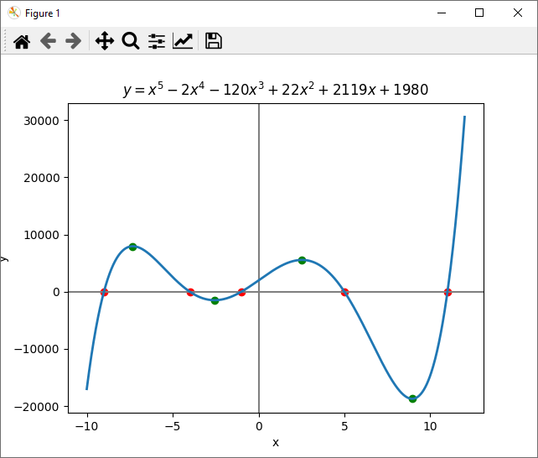
Run plot_polynomial.py
☺

Slide 21

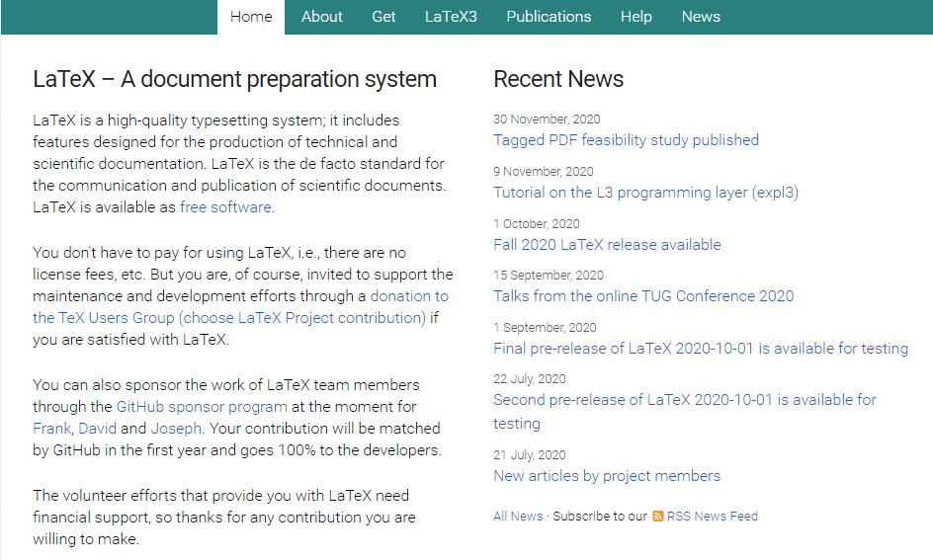
https://www.latex-project.org

Slide 22

https://www.texstudio.org
100% free – runs on Windows, Mac, Linux

Slide 23
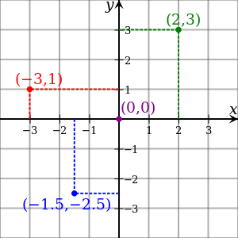
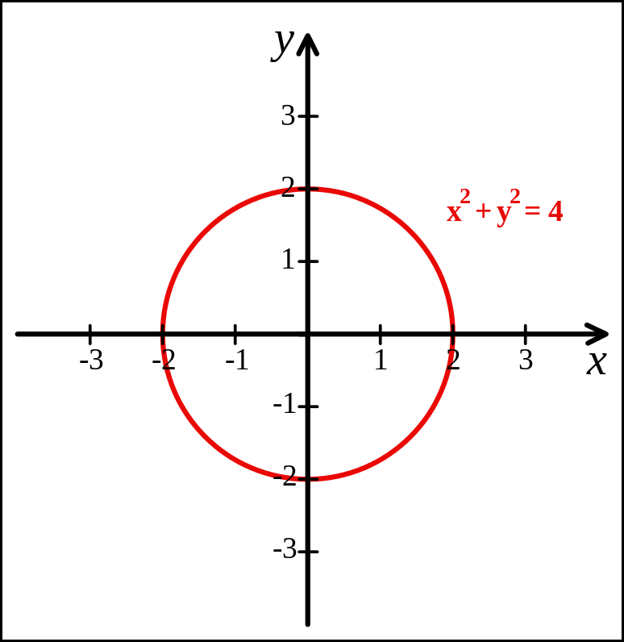
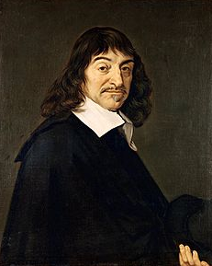
Cartesian Coordinates
Created by René Descartes in 1637

Slide 24
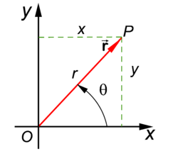
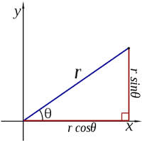
Polar Coordinates
A radius and an angle (theta)
make a 2D polar coordinate
$$(r∗\cos{θ, r ∗ \sin{θ)}}$$

Slide 25
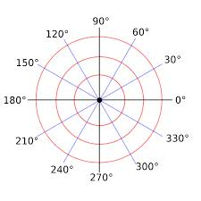
Polar Coordinates

Slide 26
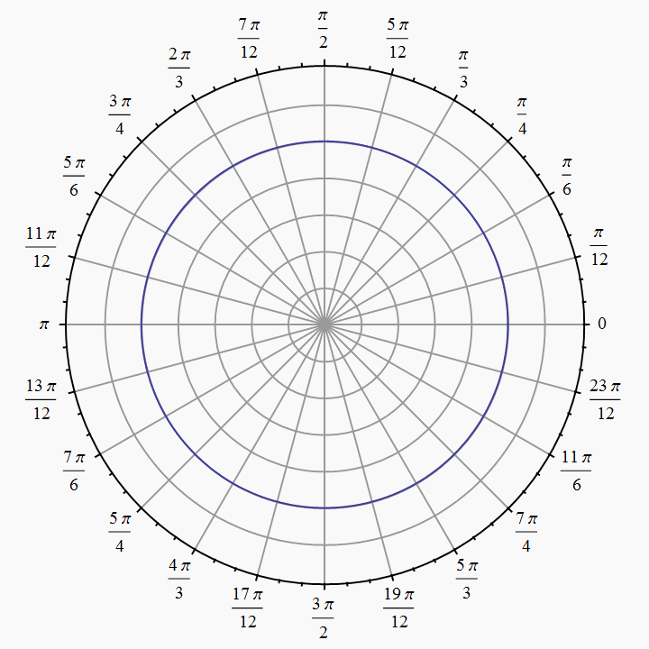
Polar Coordinates
Angles are measured in
radians
(0 ≤ θ ≤ $2π)$

Slide 27
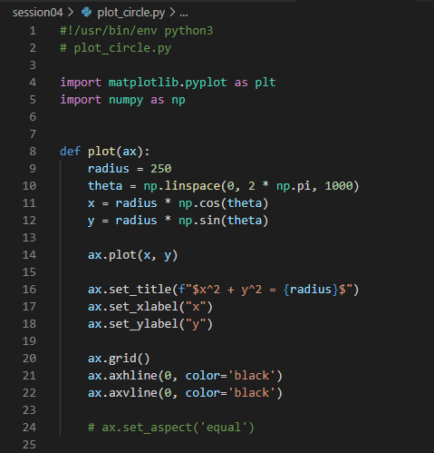
Open plot_circle.py
①
②
③
④
⑤

Slide 28
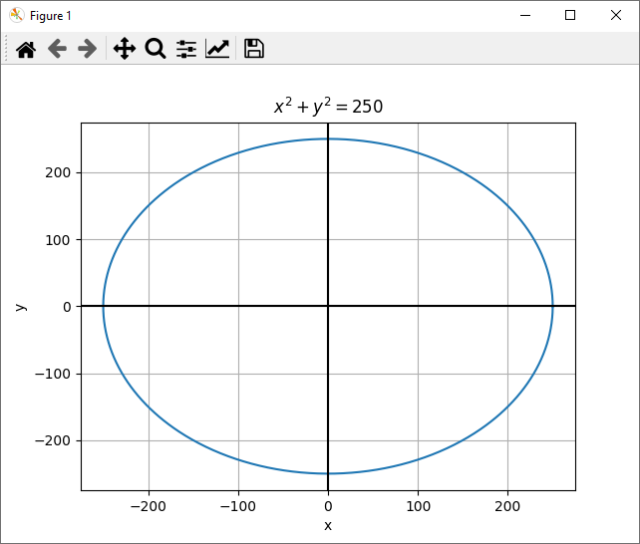
Run plot_circle.py
That looks like an ellipse!
☹

Slide 29
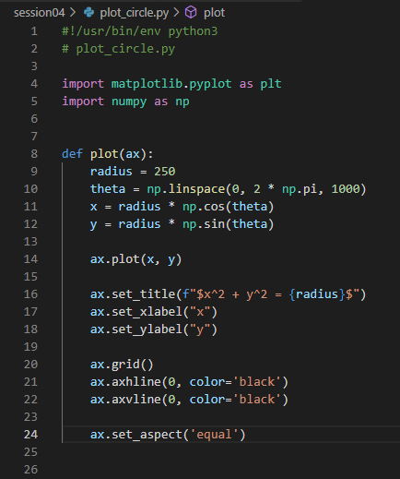
Edit plot_circle.py
Uncomment line 24

Slide 30
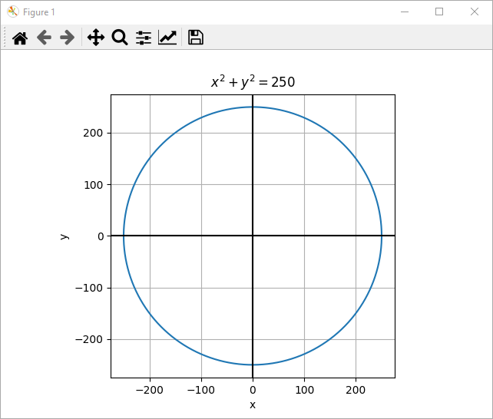
Run plot_circle.py
That looks like a circle!
☺

Slide 31
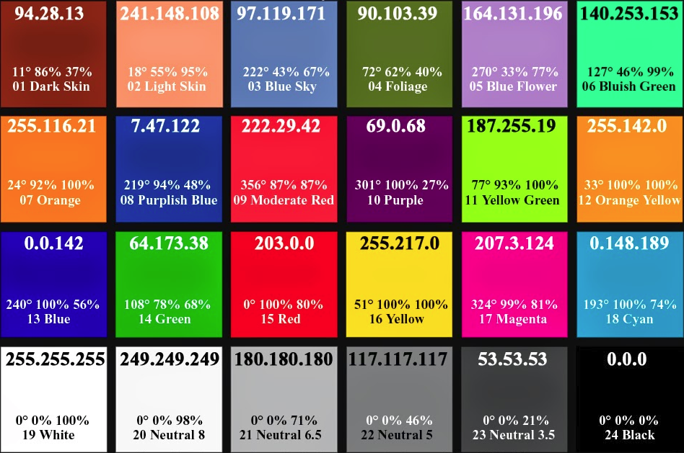
Various Colors in RGB Values

Slide 32
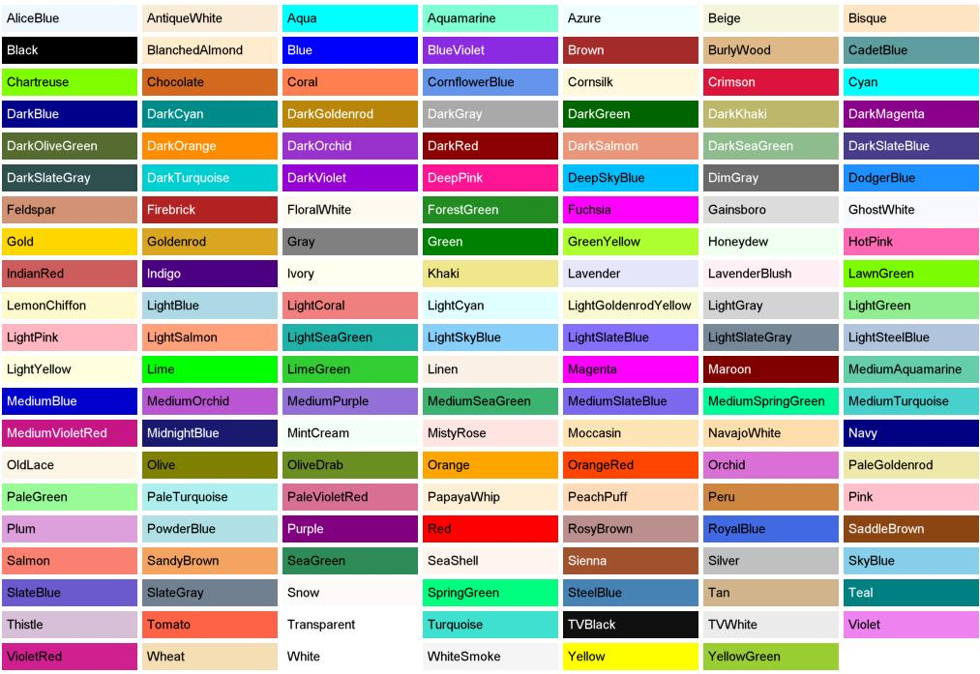
Predefined Color “Names”

Slide 33

Drawing the Olympic Rings
x_offset
(0,0)
y_offset
x_offset / 2

Slide 34
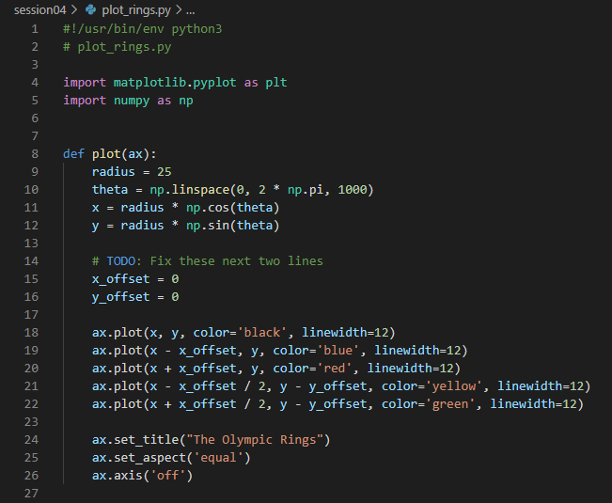
Open plot_rings.py
①
②
③
④

Slide 35
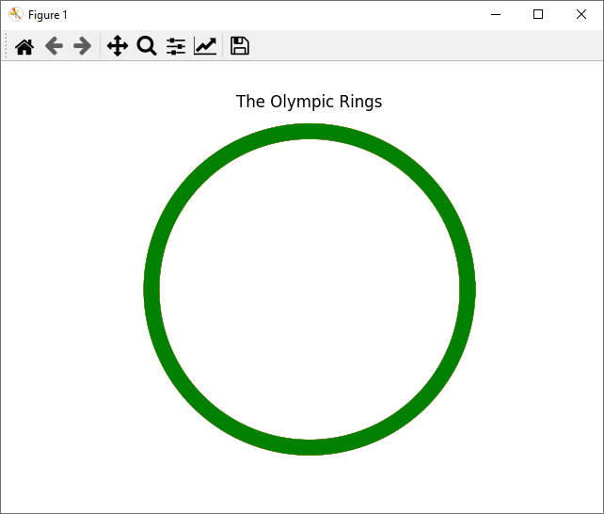
Run plot_rings.py
That doesn't look like the Olypmic Rings!
☹

Slide 36
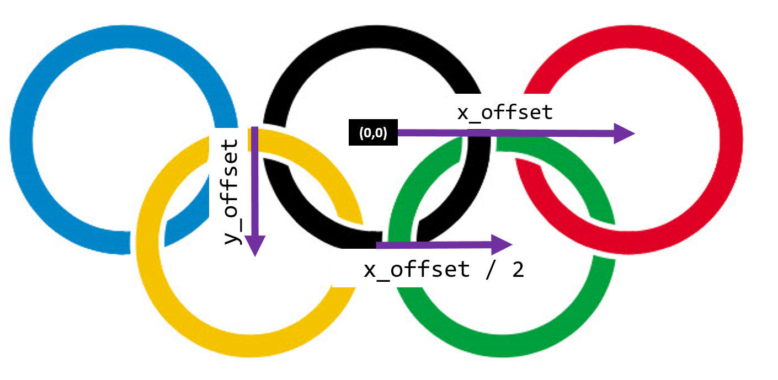
Edit plot_rings.py

Slide 37


Run plot_rings.py
☺

Slide 38
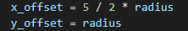
Run plot_rings.py

Slide 39
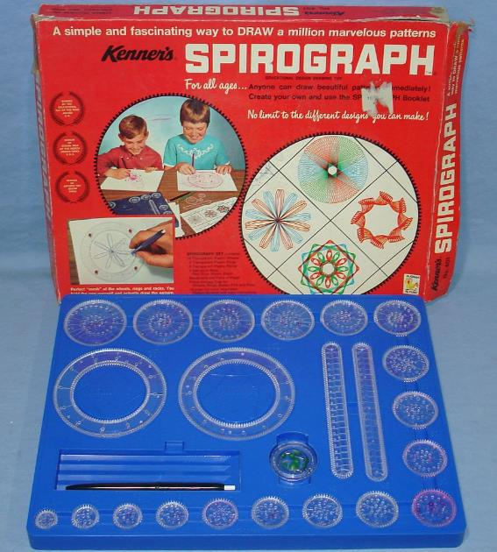
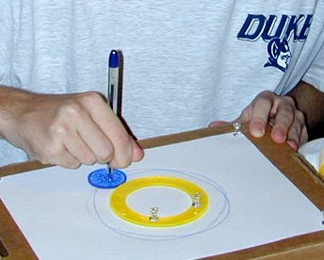
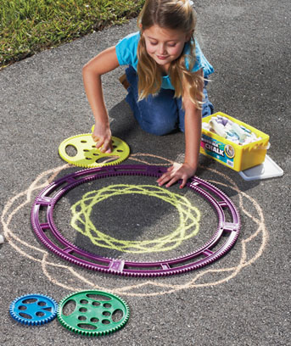

Parametric Curves

Slide 40
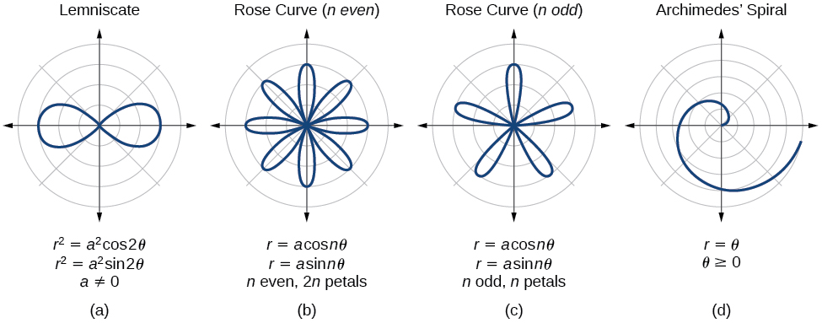
Parametric Curves
The two parameters a, n are used to calculate the current radius $r$ as $θ$sweeps the circle

Slide 41
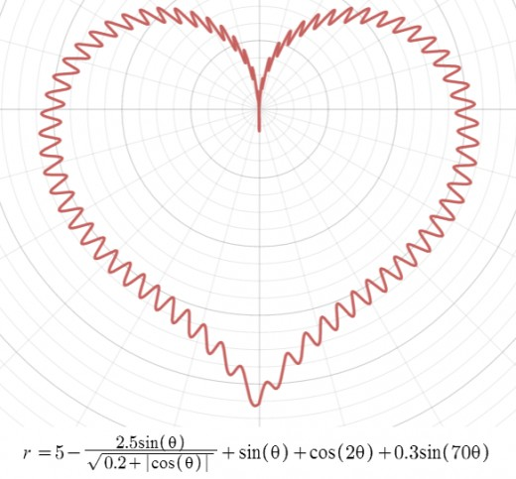
Parametric Curves

Slide 42
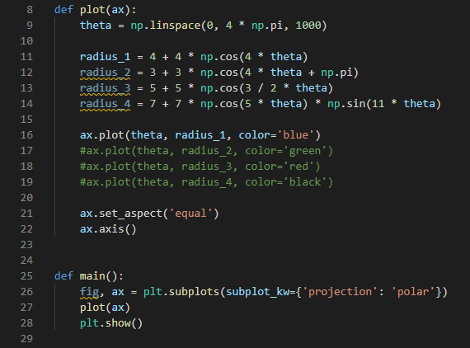
Open plot_rose_curves.py
②
③
④
①

Slide 43
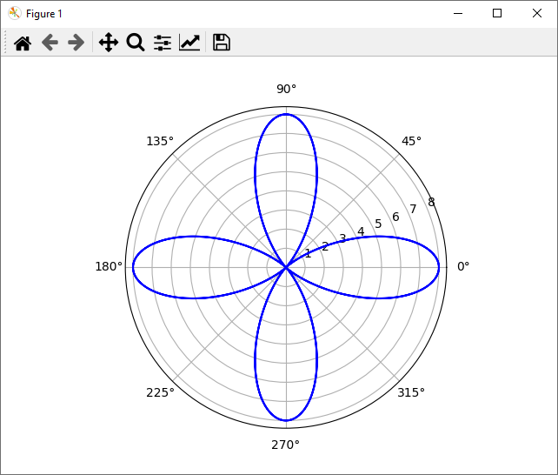
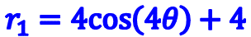
Run plot_rose_curves.py
$$r_{1}=4cos\left(4θ\right)+4$$

Slide 44
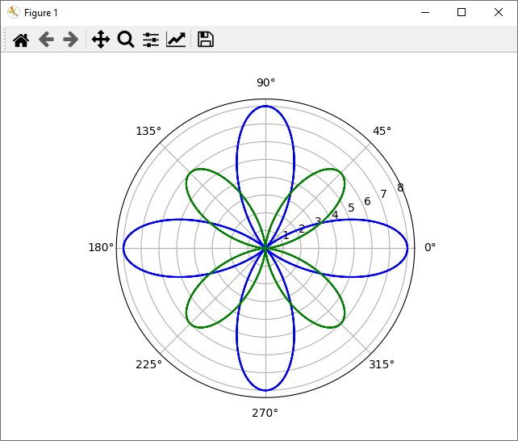
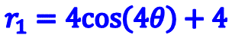

Uncomment line 17
$$r_{1}=4cos\left(4θ\right)+4$$
$$r_{2}=3cos\left(4θ+π\right)+3$$

Slide 45


Uncomment line 18
$$r_{1}=4cos\left(4θ\right)+4$$
$$r_{2}=3cos\left(4θ+π\right)+3$$
$$r_{3}=5cos\left(\frac{3}{2}θ\right)+5$$

Slide 46


Comment lines 16-18, Uncomment line 19
$$r_{4}=7cos\left(5θ\right)\sin\left(11θ\right)+7$$

Slide 47


Parametric Curves
Field Induced Polarization of Dirac Valleys in Bismuth*
$$r=\sin^{2}\left(\frac{6}{5}\right)+\cos^{2}\left(\frac{6}{1}\right)$$
*Bismuth is the element with the highest atomic mass that is stable

Slide 48

Open plot_multigraphs.py
①
②
③
[Row, Col]
④
⑤
⑥
⑦

Slide 49

Run plot_multigraphs.py

Slide 50

The Collatz Conjecture
First proposed in 1945 by Lothar Collatz, it remains unsolved
Take any positive integer n
If n is even, divide it by 2
If n is odd, multiply it by 3 and add 1
Repeat the process until n reaches 1
The conjecture is that no matter what integer you start with the process will always reach 1
It is maddening simple to state, but no one has been able to prove this claim is either true or false!
What is the sequence for 26 ?

Slide 51
The Collatz Conjecture
26
13
40
20
10
5
16
8
4
2
1
If n is even, divide it by 2
If n is odd, multiply it by 3 and add 1
Repeat the process until n reaches 1
What is the sequence for 26 ?
What is the sequence for 27 ?
26 took 10 steps to reach 1

Slide 52


The Collatz Conjecture
Step Value
Step Count

Slide 53

Stopping Time
The stopping time (for a given integer n) is the total number of Collatz iterations before reaching 1
This graph shows the stopping times for n < 10,000
Stopping times appear to exhibit a rough pattern, but we have no formula to accurately predict it for any n
Stopping Time
Increasing n

Slide 54

Frequency of Stopping Times
We are interested in analyzing the frequency (count) of each stopping time for n < 1,000,000
What is the overall shape of the distribution of stopping times?
We will use a histogram to display the count of each stopping time
Your task is to implement the stopping time function:

Slide 55


Open collatz_conjecture.py
TH1I = Histogram, 1D, Integers

Slide 56

Open collatz_conjecture.py
①
②
③
④
⑤

Slide 57

View collatz_conjecture.py
①

Slide 58

https://numba.pydata.org

Slide 59
View collatz_conjecture.py
①
②
③
④
⑤
⑥
⑦

Slide 60

Edit collatz_conjecture.py

Slide 61


Run collatz_conjecture.py
Would you have guessed the stopping time distribution takes this shape?

Slide 62
Now you know…
The package matplotlib, and its pyplot collection of functions, make Python work like MATLAB
You get a reference to a figure which contains axes and you do most things with the axes
Always size (domain and range) and decorate your plots with appropriate labels
The package sympy enables Python code to do symbolic math just like Mathematica
Using Numba can significantly improve runtime performance
Learn LaTeX – all professional publishers expect science papers to be submitted using LaTeX, not MS Word
Be mindful when drawing circles to maintain proper plot aspect ratio when rendering on a rectangular screen
You can import your own scripts into your other scripts to achieve code reuse

Slide 63
Now you know…
The Collatz Conjecture is yet another unsolved problem in number theory which is so easy to state, but so hard to prove
We know the shape of the distribution changes significantly as you analyze higher values of n – it approaches a Poisson distribution, but we don’t know the parameters
This is an excellent example of experimental computation mathematics – the computer can find the stopping time for a million integers in just a few seconds
After extensive calculations, scientists search for patterns in the data, ultimately trying to find analytic expressions that describe the underlying natural law

